Slide 1
Pixel 3 GMS App Investigations
Part 3: GMS Google Maps
Notes:
https://digitalcorpora.s3.amazonaws.com/corpora/mobile/android_10/Non-Cellebrite%20Extraction/Pixel%203.zip

Slide 2
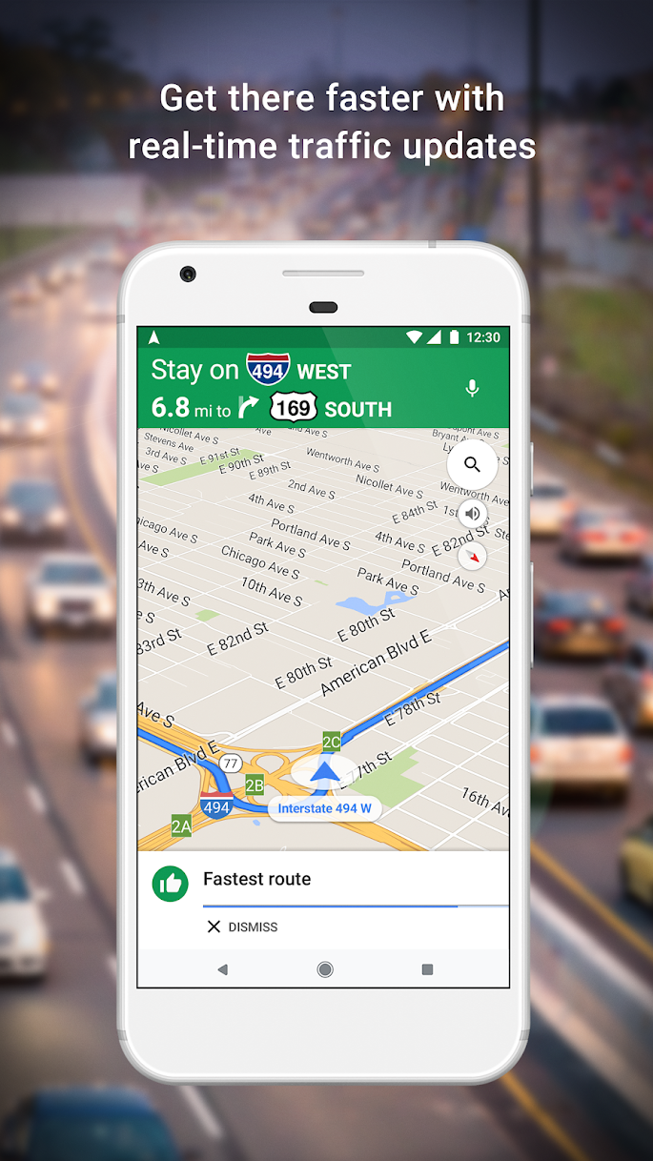
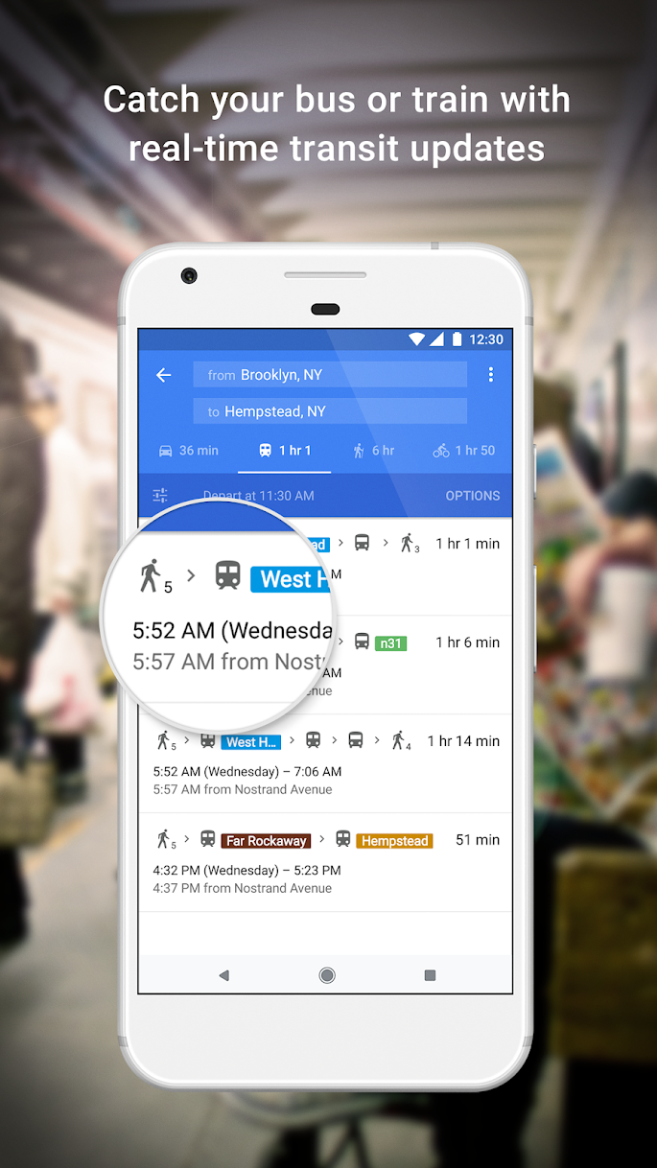
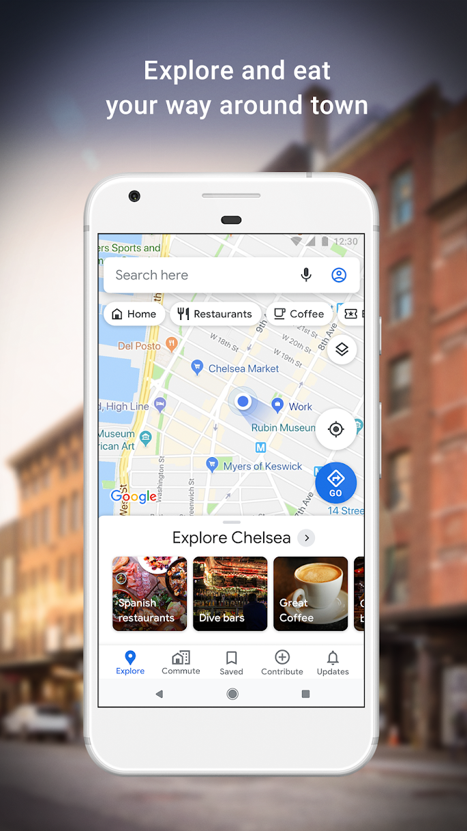

What is google maps?

Slide 3


Map evidence generation and investigations
Search for a place
get searched coordinates
Databases /Files (saved evidence)
Insert a place
get inserted coordinates
Search for a route
get searched route
Map use scenarios
investigation scenarios
Notes:
https://www.geos.ed.ac.uk/~mscgis/11-12/s1104136/design.htm

Slide 4
Forensic questions related to location data
Which places did a suspect visit and at what time?
Did the suspect save any directions in offline mode?
What was the suspect’s starting point?
What was the distance from source to destination?
Which route did the suspect choose?
Was there any toll plaza on the way?
How long does it take to reach the destination?
Did the suspect make any stops on the way?

Slide 5
Databases used by Google Maps

Slide 6
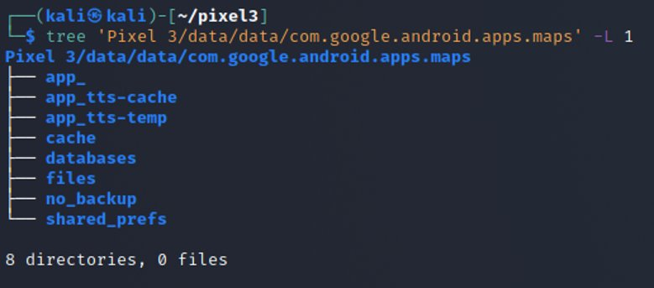
Find the databases related to Google Map
Show Google Maps package structure
-L: Level
Notes:
Cmd: tree 'Pixel 3/data/data/com.google.android.apps.maps' -L 1

Slide 7
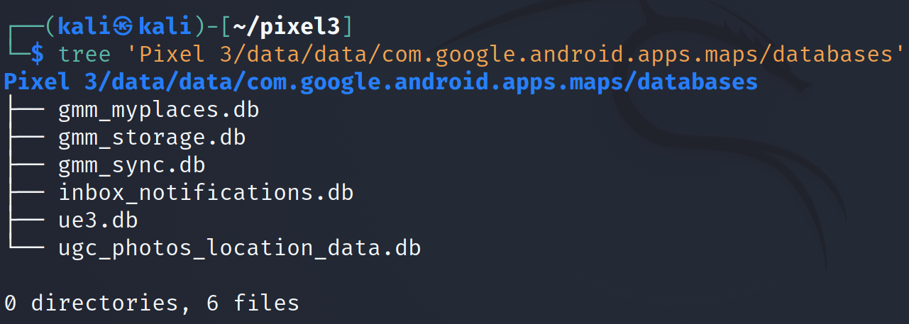
Show Google Maps databases
Notes:
Cmd: tree 'Pixel 3/data/data/com.google.android.apps.maps/databases'

Slide 8
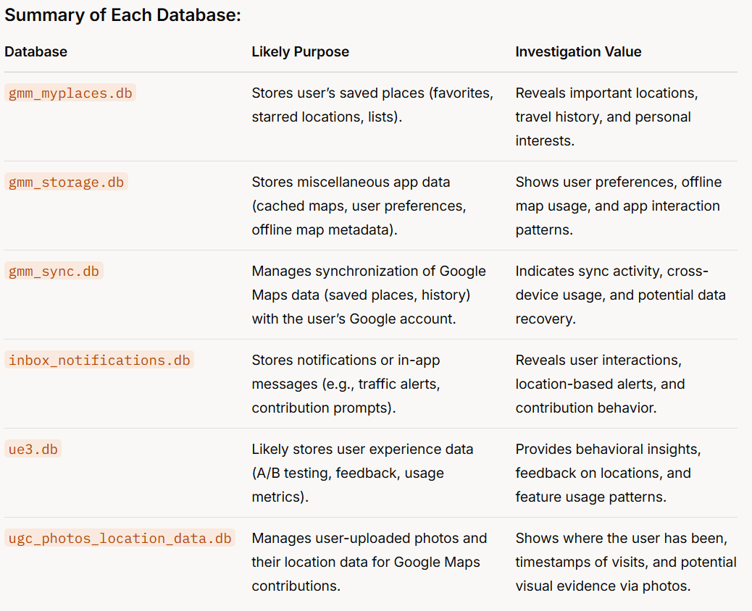
Google Maps Mobile
Location-based notifications might indicate where the user was at a specific time (e.g., a traffic alert near a certain address).
User-Generated Content
Notes:
Summary of Each Database:
DatabaseLikely PurposeInvestigation Valuegmm_myplaces.dbStores user’s saved places (favorites, starred locations, lists).Reveals important locations, travel history, and personal interests.gmm_storage.dbStores miscellaneous app data (cached maps, user preferences, offline map metadata).Shows user preferences, offline map usage, and app interaction patterns.gmm_sync.dbManages synchronization of Google Maps data (saved places, history) with the user’s Google account.Indicates sync activity, cross-device usage, and potential data recovery.inbox_notifications.dbStores notifications or in-app messages (e.g., traffic alerts, contribution prompts).Reveals user interactions, location-based alerts, and contribution behavior.ue3.dbLikely stores user experience data (A/B testing, feedback, usage metrics).Provides behavioral insights, feedback on locations, and feature usage patterns.ugc_photos_location_data.dbManages user-uploaded photos and their location data for Google Maps contributions.Shows where the user has been, timestamps of visits, and potential visual evidence via photos.

Slide 9
Investigation Value
These databases collectively provide a wealth of information about the user’s location history, travel habits, and interactions with Google Maps:
Location Tracking: gmm_myplaces.db and ugc_photos_location_data.db are particularly valuable for mapping the user’s movements and identifying significant locations.
Behavioral Patterns: ue3.db and inbox_notifications.db can reveal how the user interacts with the app and what notifications they received, shedding light on their activities and interests.
Travel Planning: gmm_storage.db might indicate offline map usage, suggesting areas the user planned to visit without internet access.
Data Synchronization: gmm_sync.db can show when and what data was synced, potentially linking to other devices or backups.

Slide 10
Location Tracking

Slide 11
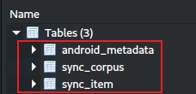
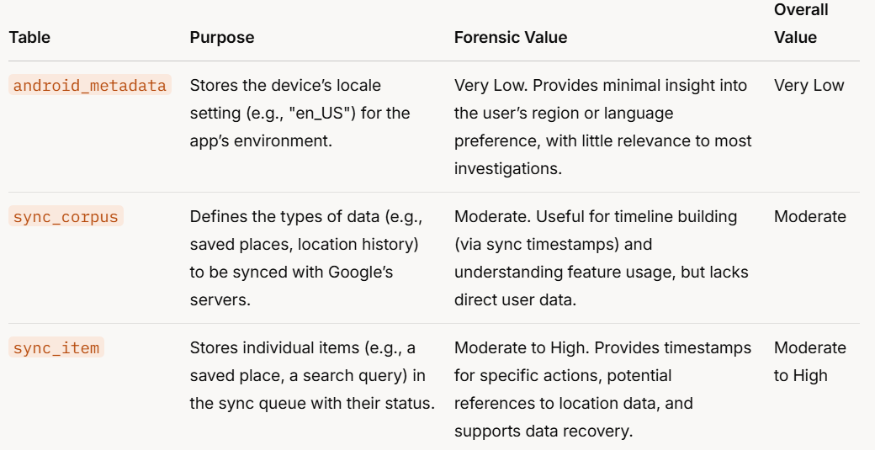
a "corpus" might represent a category of data, such as saved places, search history, location history, or user contributions (e.g., reviews, photos).
a specific piece of corpus that needs to be uploaded to or downloaded from Google’s servers.

Slide 12
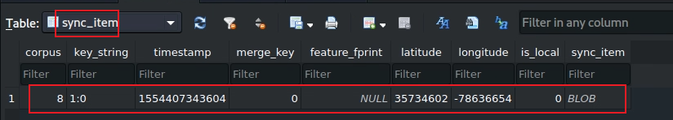
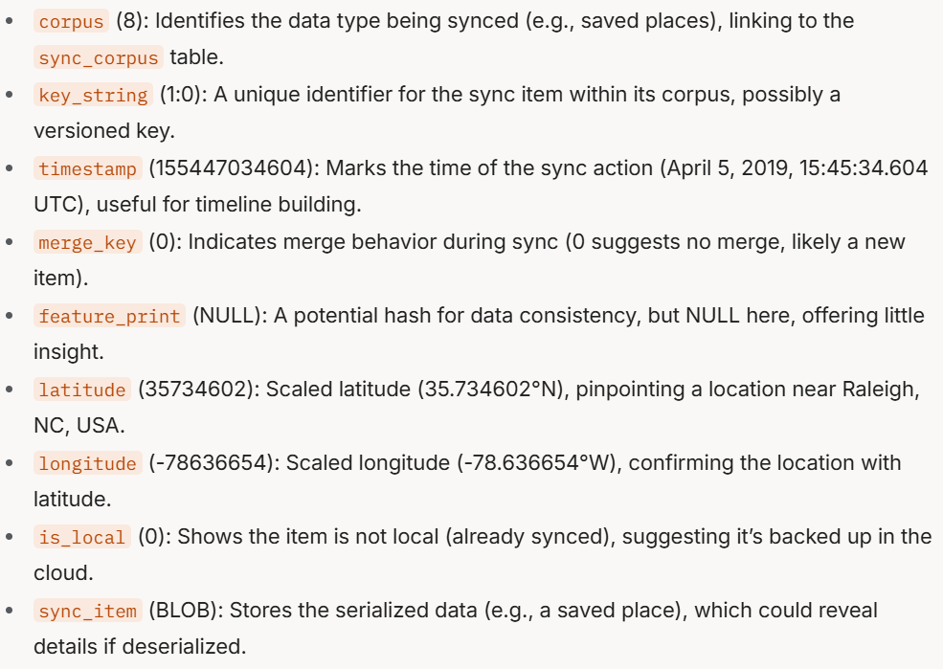
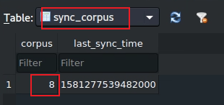
Notes:
corpus (8): Identifies the data type being synced (e.g., saved places), linking to the sync_corpus table. key_string (1:0): A unique identifier for the sync item within its corpus, possibly a versioned key. timestamp (155447034604): Marks the time of the sync action (April 5, 2019, 15:45:34.604 UTC), useful for timeline building. merge_key (0): Indicates merge behavior during sync (0 suggests no merge, likely a new item). feature_print (NULL): A potential hash for data consistency, but NULL here, offering little insight. latitude (35734602): Scaled latitude (35.734602°N), pinpointing a location near Raleigh, NC, USA. longitude (-78636654): Scaled longitude (-78.636654°W), confirming the location with latitude. is_local (0): Shows the item is not local (already synced), suggesting it’s backed up in the cloud. sync_item (BLOB): Stores the serialized data (e.g., a saved place), which could reveal details if deserialized.

Slide 13
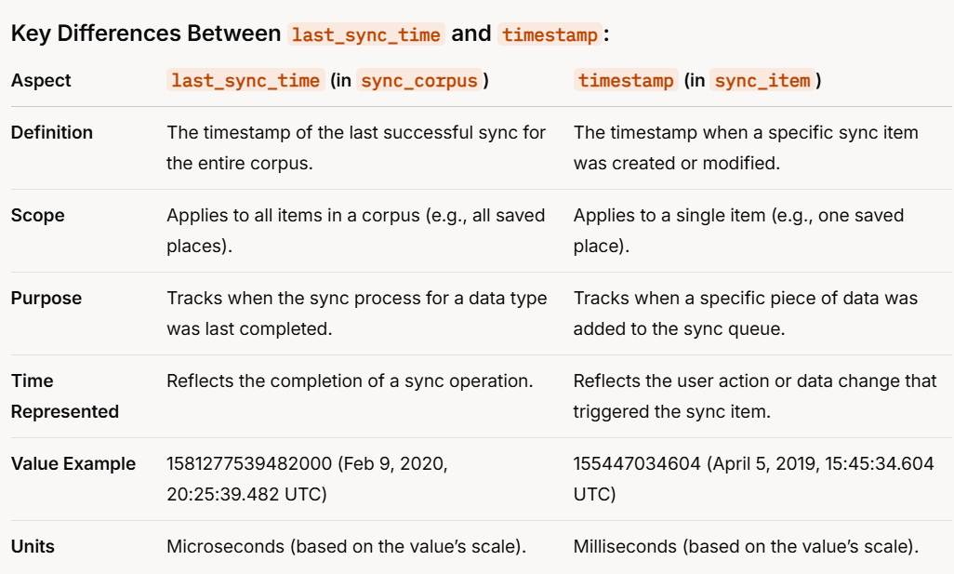
Notes:
Key Differences Between last_sync_time and timestamp:
Aspectlast_sync_time (in sync_corpus)timestamp (in sync_item)DefinitionThe timestamp of the last successful sync for the entire corpus.The timestamp when a specific sync item was created or modified.ScopeApplies to all items in a corpus (e.g., all saved places).Applies to a single item (e.g., one saved place).PurposeTracks when the sync process for a data type was last completed.Tracks when a specific piece of data was added to the sync queue.Time RepresentedReflects the completion of a sync operation.Reflects the user action or data change that triggered the sync item.Value Example1581277539482000 (Feb 9, 2020, 20:25:39.482 UTC)155447034604 (April 5, 2019, 15:45:34.604 UTC)UnitsMicroseconds (based on the value’s scale).Milliseconds (based on the value’s scale).

Slide 14
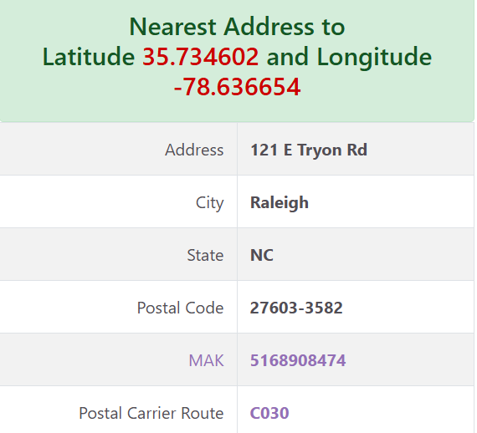
Use the below link to find the exact location using latitude and longitude​
https://www.melissa.com/v2/lookups/latlngzip4/​
​E6 format, which is a representation of latitude and longitude in microdegrees (degree=microdegrees /1,000,000)

Slide 15
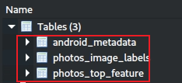
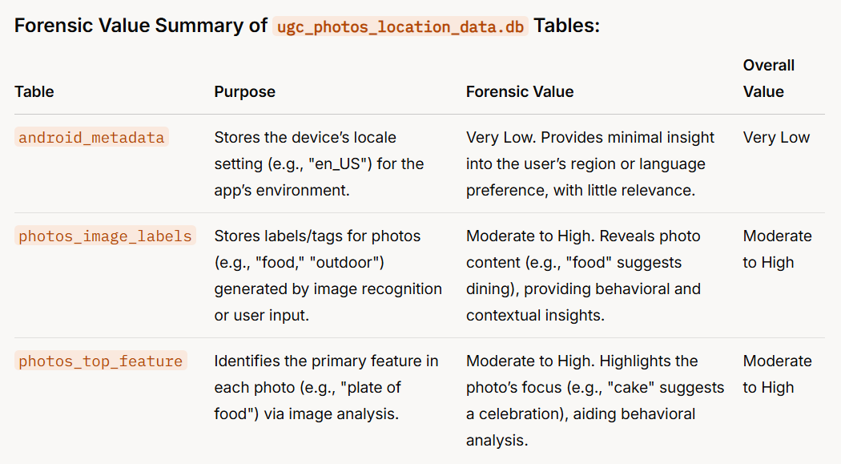
Notes:
Forensic Value Summary of ugc_photos_location_data.db Tables:
TablePurposeForensic ValueOverall Valueandroid_metadataStores the device’s locale setting (e.g., "en_US") for the app’s environment.Very Low. Provides minimal insight into the user’s region or language preference, with little relevance.Very Lowphotos_image_labelsStores labels/tags for photos (e.g., "food," "outdoor") generated by image recognition or user input.Moderate to High. Reveals photo content (e.g., "food" suggests dining), providing behavioral and contextual insights.Moderate to Highphotos_top_featureIdentifies the primary feature in each photo (e.g., "plate of food") via image analysis.Moderate to High. Highlights the photo’s focus (e.g., "cake" suggests a celebration), aiding behavioral analysis.Moderate to High

Slide 16
No values in these tables

Slide 17
Behavioral Patterns

Slide 18
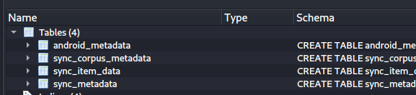
Step 2: Find the table that contains location data with timestamps
Open the database (gmm_sync.db)
Tables in gmm_sync database
Table contains location data
Notes:
Cmd: sqlitebrowser 'Pixel 3/data/data/com.google.android.apps.maps/databases/gmm_sync.db'

Slide 19
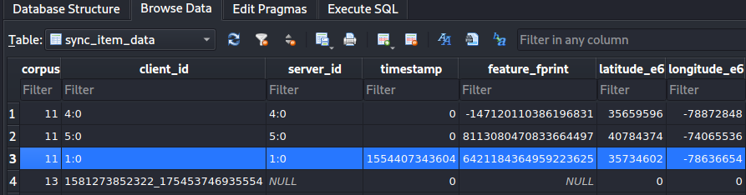
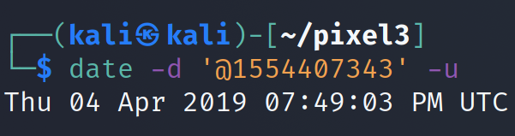
Step 3: Find the column that contains location data along with the timestamp
Open the sync_item_data table
Use the below link to find the exact location using latitude and longitude​
https://www.melissa.com/v2/lookups/latlngzip4/​
​E6 format, which is a representation of latitude and longitude in microdegrees (degree=microdegrees /1,000,000)

Slide 20
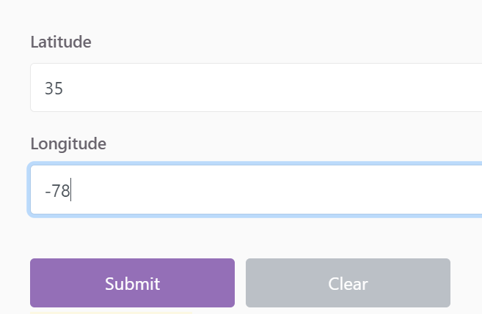
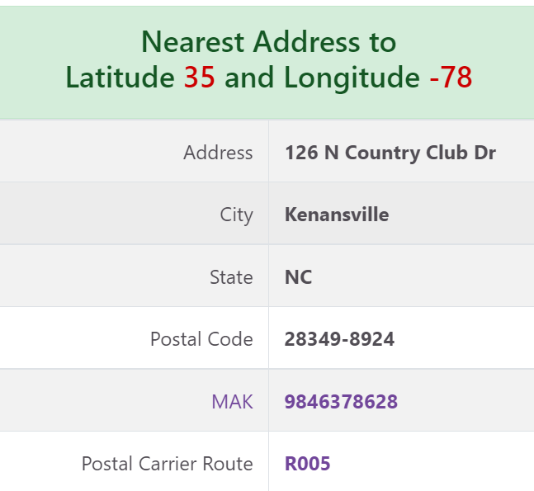
Solution to find location using latitude and longitude

Slide 21
b. Did suspect save any directions in offline mode?
Step 1: Find the files folder where offline directions are stored
Step 2: Find the file that contains the offline directions
Step 3: Open the file that contains the offline directions and look at the saved data

Slide 22
Step 1: Find the files folder where offline directions are stored
Show Google Maps package structure
Notes:
Cmd: tree 'Pixel 3/data/data/com.google.android.apps.maps' -L 1

Slide 23
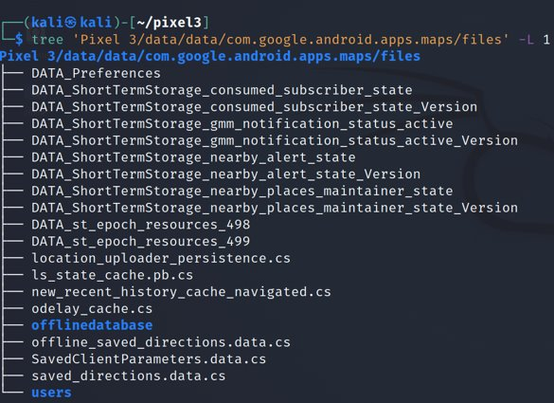
Step 2: Find the file that contains offline directions
Show Google Maps files

Slide 24
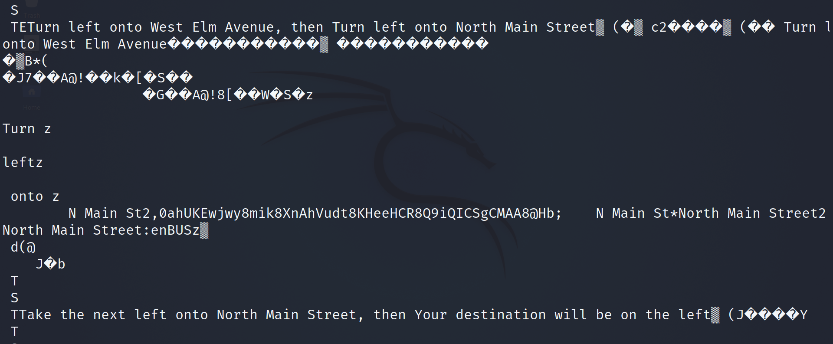
Step 3: Open the file that contains offline directions and look at the saved data
Open the file
Offline saved directions of below location

Slide 25
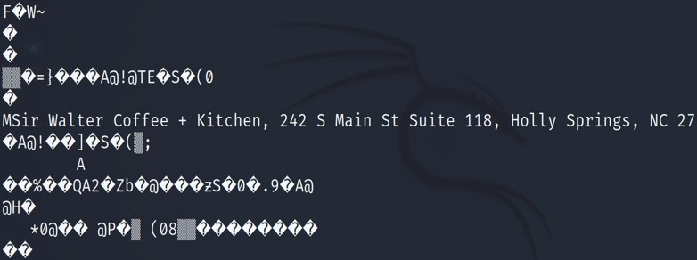
Solution

Slide 26
To summarize
Understand the application
Locate the application package/folder
Look at the application directories
Go to the "databases" directory
Open gmm_sync.db
Explore the tables
Look at the data in each column and fetch the information needed
Go to files folder to locate offline directions file
Fetch the information needed from that file

